Slide 1
CMAC 3990.200
Systems Administration and Operations
Fall 2025 – Week 12.1 – November 11th, 2025
Cloud – Elastic Load Balancers

Slide 2

Objectives
AWS and Cloud
  Examples and Walkthroughs
  Demo
  Backup
  Disaster Recovery
Disclaimer: AWS changes things a lot,
items and images may change…

Slide 3

Weekly Info
“If you can’t measure it, you cant improve it.”
  Peter Drucker
Attendance
Good of the class
Presentation Reminder
  Presentation Date: December 2nd, 2025
Assignment 11 - Due November 14th
Assignment 12 – Due November 21st
Assignment 13 – Due December 5th
Assignment AWS – Due December 5th
Remaining Points (784 total):
  Attendance (weeks 12, 13, 15): 18 points
  Presentation & Project: 300 points
  Assignments 11-13: 200 points
    60-75 points each
  Final Exam: 266 points
  Bonus AWS: 50 points
Final Exam
  December 9th, 2025
    5:00PM to 7:00PM

Slide 4

Cloud Computing
What is cloud computing?
  Computing in the cloud
  Using resources made available over the internet
  to run workloads
  Things as a Service (XaaS)
    Pizza as a service!
  Someone else’s data center!
  Serverless Architecture
    Look ma, no servers!
Cloud Computing Providers
  Amazon Web Services (AWS)
  Google Cloud Platform (GCP)
  Microsoft Azure
  Linode, Akami, Digital Ocean, Vultr, Others…

Slide 5
Cloud Computing
The on-demand availability of computer system resources, with a level of abstraction from direct user interaction
  Depending on the cloud service, you may have different levels of access
  The provider can offer services at multiple levels
  Geographically different locations for availability
    Eastern US, Western US, Europe, Asia, etc.
  Typically a pay per use model
    $0.10/hour ≈ $70/month
    Extras…
  Amazon started AWS in 2006
    Others followed, such as Google, Microsoft, and others
  Allows users to leverage a large, resilient, fault tolerant
  infrastructure platform with minimal knowledge of the
  underlying hardware and software technologies

Slide 6
Cloud Computing
Several key characteristics identify cloud computing:
  Agility to move and adjust
  Lower cost/barrier to entry
  Reduction of maintenance and overhead costs
  Reliability and scalability
  Enhanced security
  Advanced monitoring, logging, and statistics
Cloud computing can be on or off-premises
  On-prem: A cloud-like environment in your data center
  Off-prem: A cloud-like environment on the internet
Flexibility is key!
Someone else’s datacenter!

Slide 7
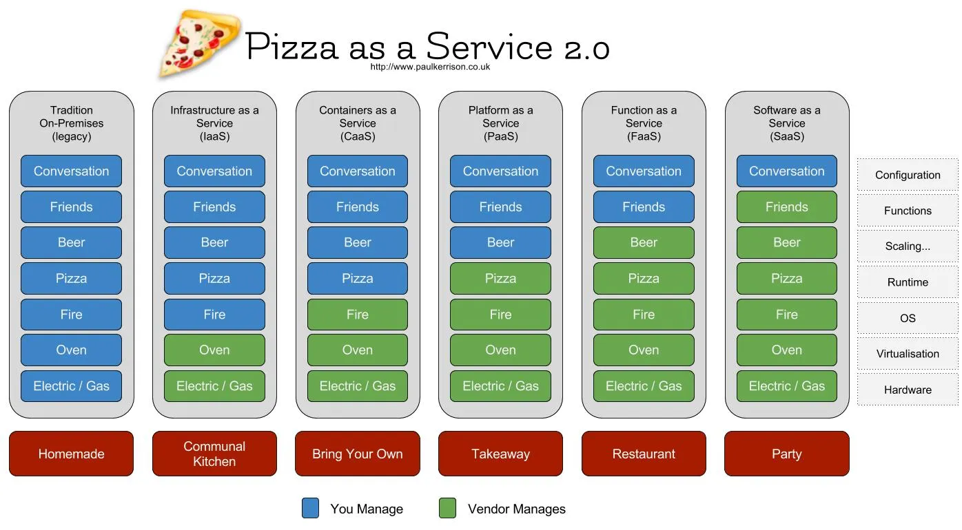
Pizza as a Service

Slide 8
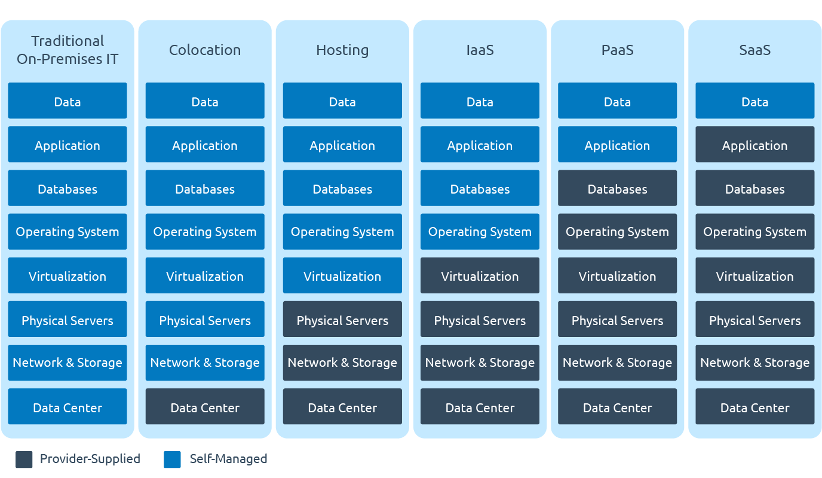
X as a Service (XaaS)

Slide 9

Compute
Brains and processing power
CPU/RAM
Server in a data center
Full VM (or physical machine) dedicated to you
  Tons of different sizes and shapes
  Optimize for your workload
Temporary code execution on a
non-dedicated machine
  Serverless Computing
EC2 – Elastic Compute Cloud
ECS – Elastic Container Service
ECR – Elastic Container Registry
EKS – Elastic Kubernetes Service
AWS Elastic Beanstalk
AWS Lambda
AWS Batch
AWS Lightsail

Slide 10
Elastic Compute Cloud (EC2)
EC2 – A virtual machine within your virtual AWS environment
  Amazon Machine Images (AMI’s)
    Template used to build a new server
    Create your own
    Marketplace, Community
  Instance Types
    Color, size, and shape of turtle (CPU/RAM/Network/Turbo/etc)
    Micro, General Purpose, Compute Optimized, GPU, FPGA, Memory, Storage
  Purchasing Options
    On-Demand
    Reserve 1+ years – Pay more up front for a better discount
    Scheduled – Reoccurring Schedule
    Spot – Unused resources – priced based on supply and demand
      Can be terminated with only a 2 minute warning.
    Reservations – Reserve capacity for a time

Slide 11
Elastic Compute Cloud (EC2)
EC2 – A virtual machine within your virtual AWS environment
  Tenancy – Where your VM actually runs
    Shared, Dedicated Instances, Dedicated Hosts
  User Data – Startup scripts
    Install things automagically!
  Storage
    Persistent Storage – EBS Volumes
      Separate from your instance, network connected, think “D:\” drive or a network NAS drive
      Attach/Detach, Encryption, snapshots, compression, replication…
    Ephemeral Storage – OS volumes
      Physically connected to the host, data lost when instance is terminated, cannot detach
  Security
    Security Group – A firewall for your EC2 Instance – Ports, protocols, sources, destinations…
    Key Pairs – Public/Private key used for authentication – AWS keeps public key, you keep private key
    It is your responsibility to maintain OS or application security and updates!

Slide 12
Amazon Web Services - AWS
AWS Free Tier
  Three types of free tier offerings
    Free Trials
      Machine Learning
      Lightsail VPS
      DocumentDB/MongoDB
    12 months free
      t2/t3.micro EC2 instance (2 vCPU, 1GB RAM, 30GB SSD)
      5GB S3 Storage
      Amazon Managed Relational Database Service (RDS)
    Always free (with limits on usage)
      AWS Lambda
      AWS Simple Notification Service (SNS)
      AWS Key Management Service (KMS)

Slide 13
Amazon Web Services
EC2 – Elastic Compute Cloud – The Amazon Web Services component
Instance – Virtual Machine – A running VM, similar to our class VM’s
Amazon Machine Image (AMI) – Template – An OS installed and pre-configured to quickly deploy
Virtual Private Cloud (VPC) – Network – A virtual private non-routable network subnet
Internet Gateway (IGW) – Gateway/router – Next hop to the internet
Region – A generalized location where AWS physical services are located
Availability Zone – An individual data center within a region
Security Group – A virtual firewall
Elastic Load Balancer (ELB) – The Elastic Load Balancing Service from Amazon
will automatically distribute incoming application traffic across multiple
Amazon EC2 instances.
  Load balancers allow you to achieve fault tolerance in your applications,
  seamlessly providing the required amount of load balancing capacity
  needed to route application traffic.

Slide 14
Elastic Load Balancer
Multiple types of load balancers are available – all which feature high availability, automatic scaling, and robust security.
  The ELB Service automatically distributes incoming traffic across multiple Amazon EC2 instances.
    Enables fault tolerance in your applications, seamlessly providing the required amount of load balancing capacity needed to route application traffic.
The Classic Load Balancer routes traffic based on either application or network level information
  Ideal for simple load balancing of traffic across multiple EC2 instances
  Classic Load Balancers are the “previous generation” of load balancer and shouldn’t be used…
The Application Load Balancer routes traffic based on advanced
application information that includes the content of the request.
  Ideal for applications needing advanced routing capabilities, microservices,
  and container-based architectures.
  Application Load Balancer offers the ability to route traffic to multiple services
  or load balance across multiple ports on the same EC2 instance.

Slide 15
Elastic Load Balancer
Multiple types of load balancers are available – all which feature high availability, automatic scaling, and robust security.
The Network Load Balancer offers ultra-high performance, TLS offloading, and more
  Operates at the connection level
  Capable of handling millions of requests per second
  Maintains ultra-low latencies
The Gateway Load Balancer supports third-party GENEVE appliances
  GENEVE: Generic Network Virtualization Encapsulation
  Allows for improved security, compliance, and policy controls

Slide 16

Elastic Load Balancer
The ELB Service automatically distributes incoming traffic across multiple Amazon EC2 instances.
  Enables fault tolerance in your applications, seamlessly providing the required amount of load balancing capacity needed to route application traffic.
Elastic Load Balancing offers two types of load balancers
  Both load balancers feature high availability, automatic scaling, and robust security!
  The Classic Load Balancer routes traffic based on either application or network level information
    Ideal for simple load balancing of traffic across multiple EC2 instances
  The Application Load Balancer that routes traffic based on advanced application level information
    This info will include the content of the request
    Ideal for applications needing advanced routing capabilities,
    microservices, and container-based architectures.
    Provides the ability to route traffic to multiple services or
    load balance across multiple ports on the same EC2 instance.

Slide 17
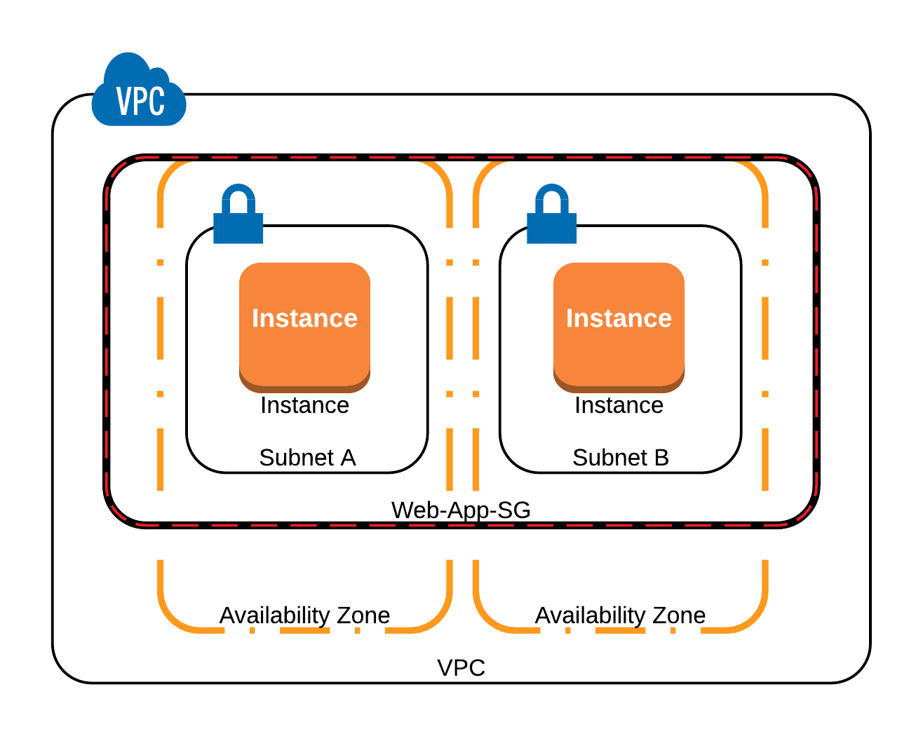
Elastic Load Balancer
Two Web Server Instances
  Two separate subnets
  Two separate Availability Zones
  One Virtual Private Cloud
  One Region
  One Security Group
High Availability Design!
  We can take one instance offline at
  a time with no disruption to our website!
  Blue/Green upgrades
  Rolling upgrades
  Provides for automatic scaling!

Slide 18
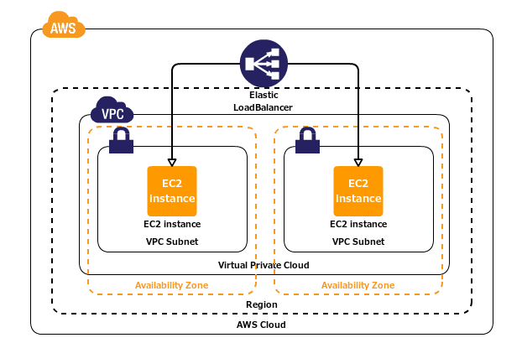
Elastic Load Balancer
In our example, we already have a VPC with
multiple subnets and two EC2 instances running
inside the VPC in different Availability Zones.
Both instances are inside the same Security Group
called Web-App-SG, which is allowing HTTP access
to port 80 from anywhere (0.0.0.0/0).
Each EC2 instance is running the same web app.
We want to configure an LB to create a central
point of access to our application
We also want to configure our architecture in a
way that users can only access the application
through the ELB.

Slide 19
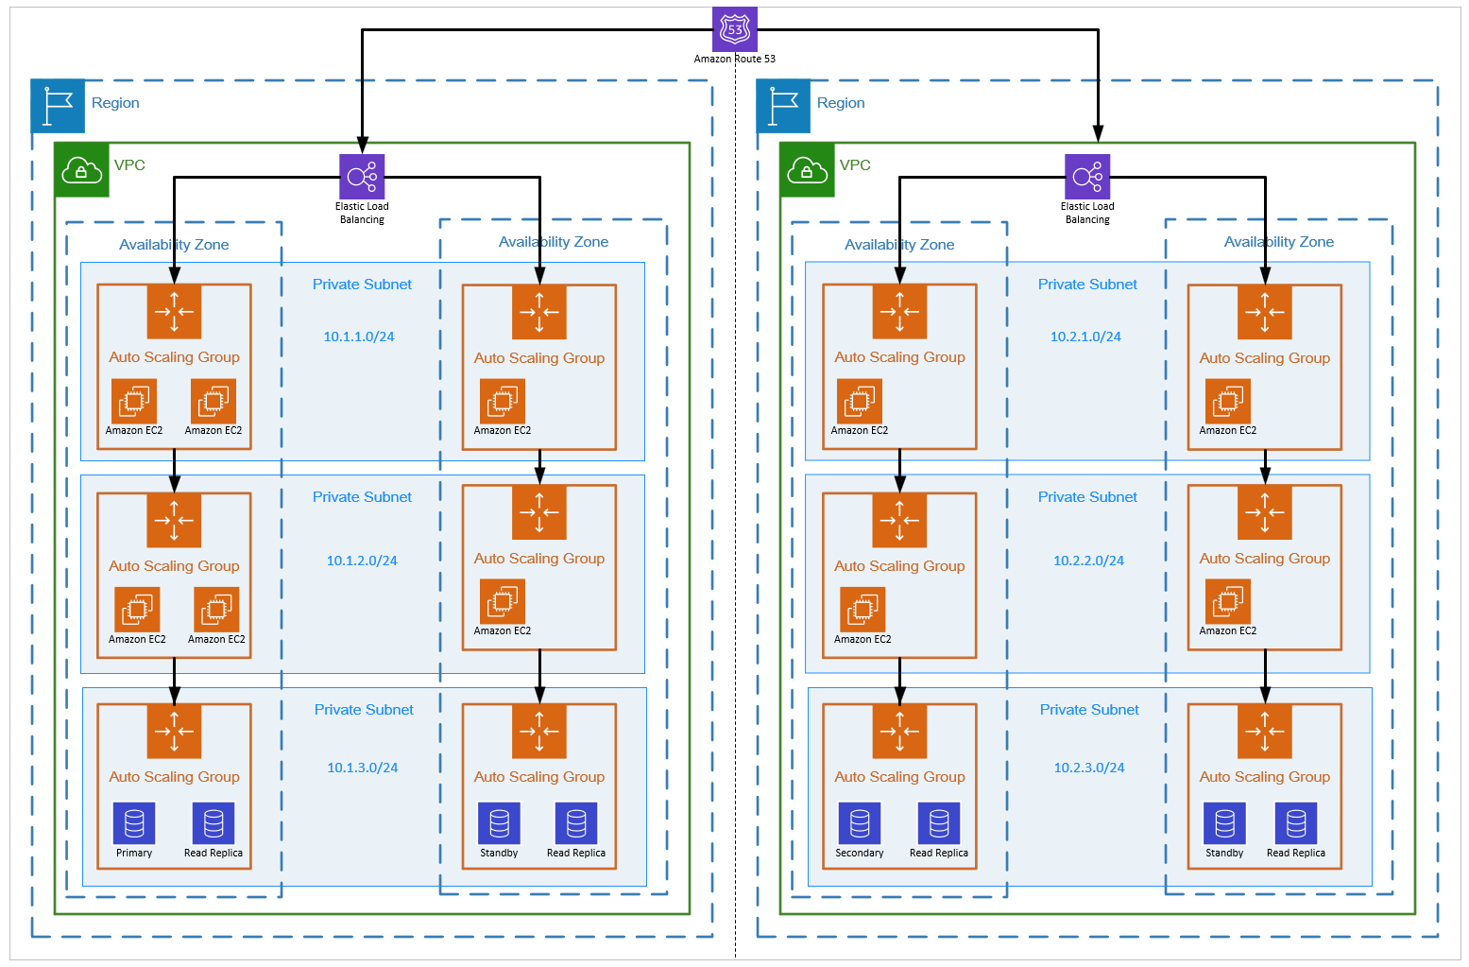
Multi-Region HA Environment

Slide 20
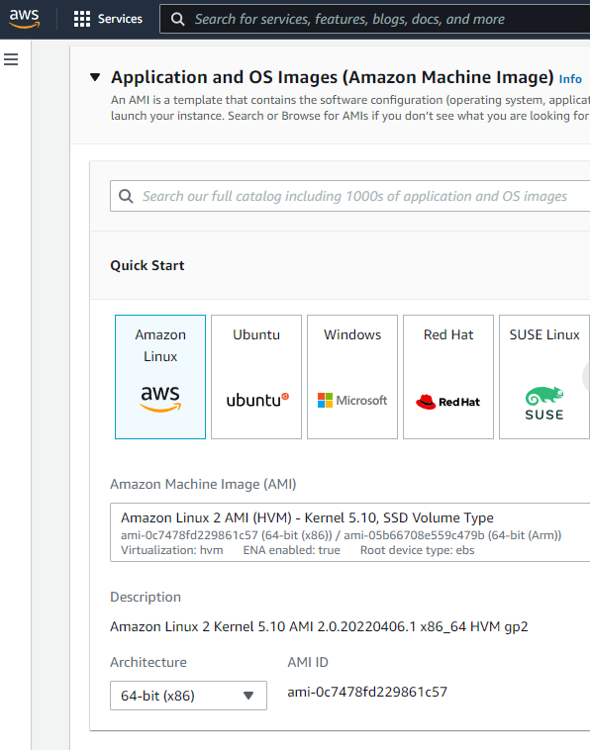
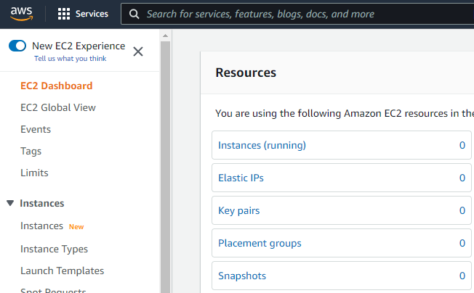
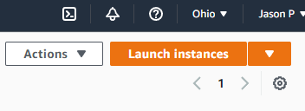
Launch an EC2 Instance
Login to AWS and browse to the EC2 dashboard, and select Instances
  This console will show you any running EC2 instances you may have
  Select Launch Instances in the upper-right corner
    This will take you to some options to build machines
  Browse through the list of available instances and options

Slide 21
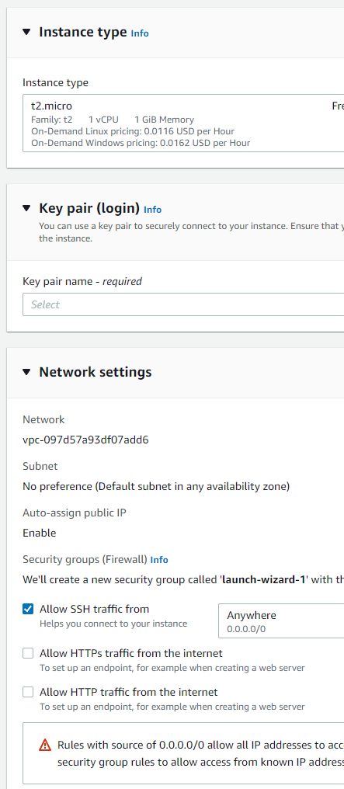
Launch an EC2 Instance
Create a new Instance
  Browse through the list of available instances and options
    Amazon Linux, Ubuntu, Windows, Red Hat, more…
    These are built from Amazon Machine Images (AMI’s)
      You can potentially create your own AMI’s
    Multiple instance types to specify different configurations
      Free tier t3.micro
        2 vCPU’s, 1GiB RAM, 30GiB Storage
    Network settings to configure security groups!
    Key pairs are required for login!
      Either select or create a new keypair
        Putty will use a .ppk file, ssh uses a .pem file
          The .pem file is our typical private key file
    Additional advanced configuration options
      Spot instances, tagging, userdata files, etc…

Slide 22

Launch an EC2 Instance
Create a new Instance
  Configure Instance – Give it a name!
    AMI is Amazon Linux 2023 kernel-6.1
    Architecture is 64-bit (x86)
    Instance type is t3.micro
    Make sure you have the private key file! (Create a new one if needed?!)
    Network settings: Create security group
      Allow SSH, HTTP, and HTTPS traffic from the internet
    Configure storage: Leave as default 8GiB gp3
    Add the following to the User data in the Advanced Details:
        #!/bin/bash
        sudo dnf upgrade --releasever=latest -y; sudo dnf -y update
        sudo dnf -y install httpd mod_ssl
        sudo systemctl enable httpd
        sudo echo "Hello CMAC3390-1<br>" > /var/www/html/index.html
        TOKEN=$(curl -X PUT "http://169.254.169.254/latest/api/token" -H "X-aws-ec2-metadata-token-ttl-seconds: 21600")
        curl -H "X-aws-ec2-metadata-token: $TOKEN" -v http://169.254.169.254/latest/meta-data/instance-id >> /var/www/html/index.html
        sudo chmod 644 /var/www/html/index.html
        sudo reboot
IMDSv1
vs
IDMSv2!

Slide 23
Launch an EC2 Instance
Create another new Instance
  Configure Instance – Give it a name!
    AMI is Amazon Linux 2023 kernel-6.1
    Architecture is 64-bit (x86)
    Instance type is t3.micro
    Make sure you have the private key file! (Create a new one if needed?!)
    Network settings: Create security group
      Allow SSH, HTTP, and HTTPS traffic from the internet
    Configure storage: Leave as default 8GiB gp3
    Add the following to the User data in the Advanced Details:
        #!/bin/bash
        sudo dnf upgrade --releasever=latest -y; sudo dnf -y update
        sudo dnf -y install httpd mod_ssl
        sudo systemctl enable httpd
        sudo echo "Hello CMAC3390-2<br>" > /var/www/html/index.html
        TOKEN=$(curl -X PUT "http://169.254.169.254/latest/api/token" -H "X-aws-ec2-metadata-token-ttl-seconds: 21600")
        curl -H "X-aws-ec2-metadata-token: $TOKEN" -v http://169.254.169.254/latest/meta-data/instance-id >> /var/www/html/index.html
        sudo chmod 644 /var/www/html/index.html
        sudo reboot
IMDSv1
vs
IDMSv2!

Slide 24
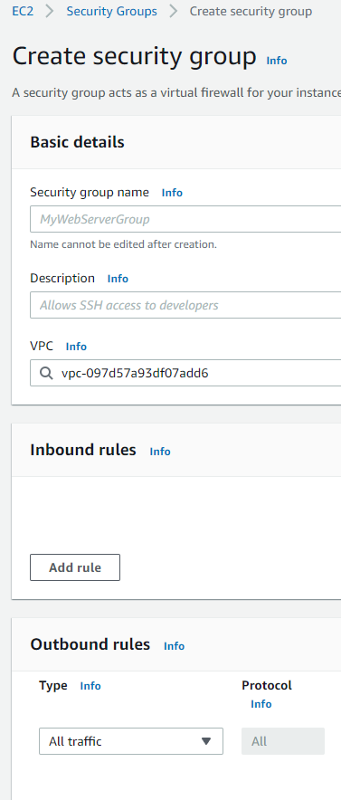
Configure Security Groups
New EC2 instances are part of new launch wizard security groups
  We want our own security groups!
Create a new security group
  Under Network & Security within EC2 → Security Groups → Create Security Group
  Name our new security group Web-App-SG
  Create a description as well – it is required – Web-App-SG
  Add rules to allow inbound HTTP and HTTPS traffic
    Use the IPv4 anywhere source
Add our new SG to our instance
  Go back to instances and select each of our new instances individually
  From the Actions drop down, select Security and Change Security Groups
    Select our new Web-App-SG from the list and click Add Security Group
    Leave the launch wizard security group for now…

Slide 25
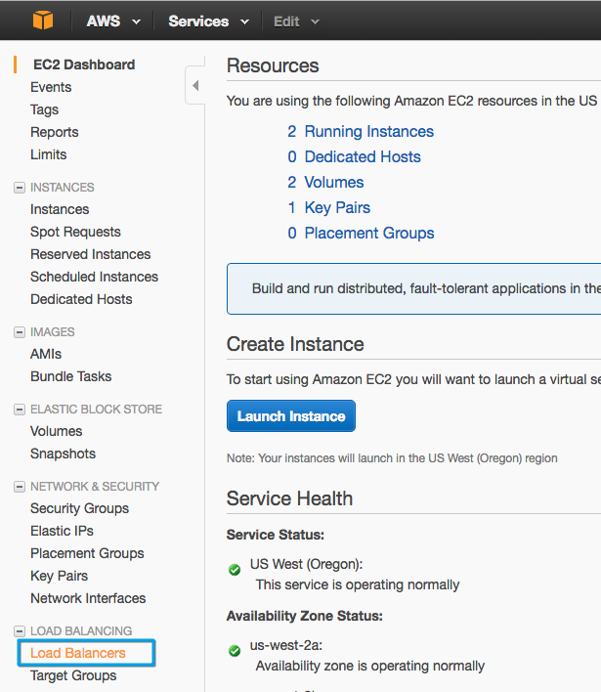
Elastic Load Balancer
Notice the 2 running instances
We will navigate into the Load
Balancers section

Slide 26
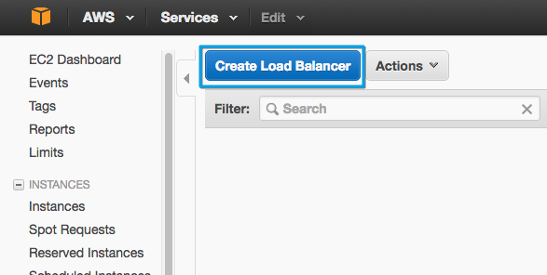
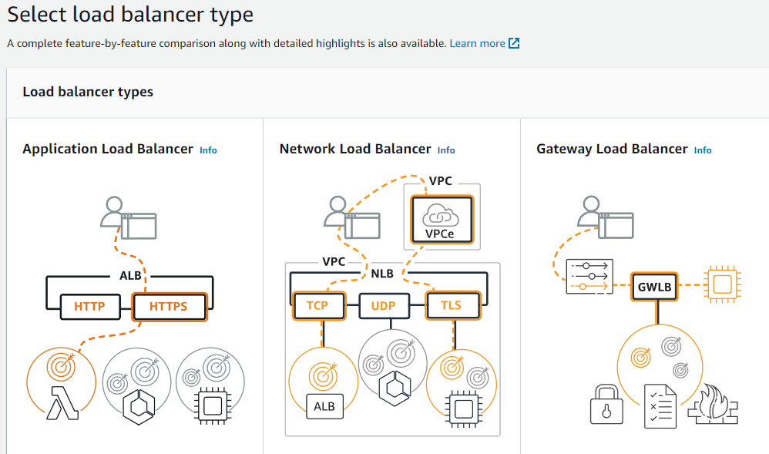
Elastic Load Balancer
We will click on Create Load Balancer
Next we select the Application Load Balancer
Now we can start to configure our ELB!
  Make sure to give it a name! MyELB

Slide 27
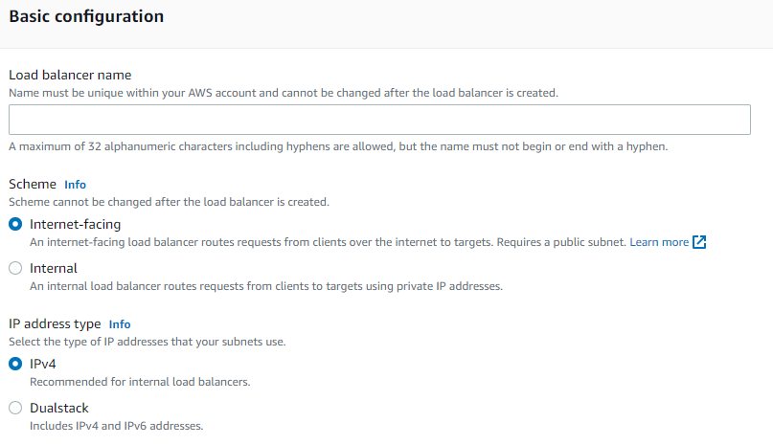
Elastic Load Balancer
Some info about the next config points
  We will create an LB to receive traffic from the internet and forward to our instances, therefore we need a publicly accessible LB (Internet-facing).
  If you create an internal load balancer you will be creating a load balancer that won't be publicly accessible
    In this case, the LB would only be accessible
    from inside the VPC, which is not the goal.
There are instances running in different
availability zones - we need to configure
the LB to work in all subnets where we
will be launching web instances.
  Select each AZ and a subnet from each
  We only have one VPC to worry about
Also add our new Web-App-SG security group
  Leave the default SG for now

Slide 28
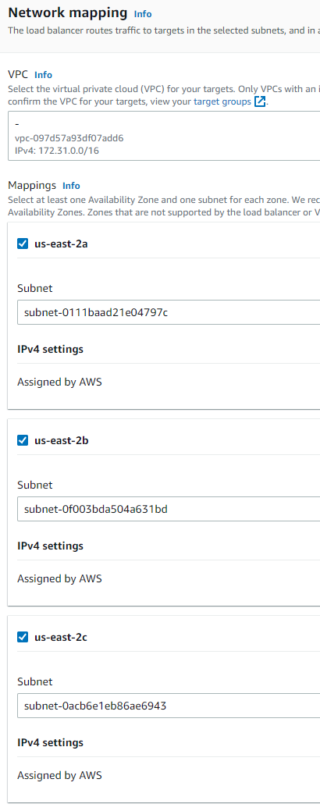
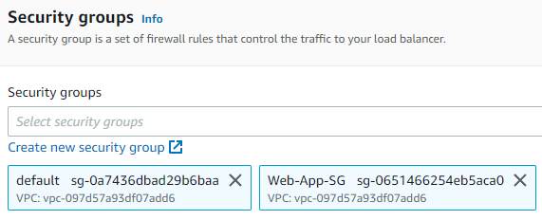
Elastic Load Balancer
A LB listens to a specific port for requests coming from outside, and forwards the
request to the instances running behind it on a specific port – Port forwarding!
  We will be using the port 80 for HTTP requests for both ELB and the EC2 instances
    We need to create a target group for routing!
    Create target group → Instances
      Give it a name, HTTP1 protocol version, port 80, HTTP health check, next…
      Select both of our instances, include as pending below…
      Create target group!
    Back on our LB - Refresh the list of available target groups, and select the new group
    Optionally add HTTPS port 443 as well…
      It will require an SSL cert!
      Skip this part…
    Create and view!

Slide 29
Elastic Load Balancer
There are some Advanced details you can configure, but for the purposes of this lab we will stick with the default settings. However, for your reference, this is what they mean:
  Response Timeout: The amount of time to wait when receiving a response from the health check,
  in seconds. Valid values: 2 to 60. Default: 5
  Health Check Interval: The amount of time between health checks of an individual instance,
  in seconds. Valid values: 5 to 300. Default: 30
  Unhealthy Threshold: The number of consecutive failed health checks that must occur before declaring an EC2 instance unhealthy. Valid values: 2 to 10. Default: 2
  Healthy Threshold: The number of consecutive successful health checks
  that must occur before declaring an EC2 instance healthy.
  Valid values: 2 to 10. Default: 10

Slide 30
Elastic Load Balancer
There are additional config points in here as well:
  Cross-Zone Load Balancing is used to ensure that your ELB distributes incoming requests evenly across all instances in its enabled Availability Zones. That means that the ELB will ignore the default of round-robin and will also take into consideration the Availability Zone in which the instance is running. This reduces the need to maintain equivalent numbers of instances in each enabled Availability Zone, and improves your application's ability to handle the loss of one or more instances.
  Connection Draining is used to ensure that a Classic Load Balancer stops
  sending requests to instances that are de-registering or unhealthy while
  keeping the existing connections open.
For our purposes, we will use the default settings

Slide 31
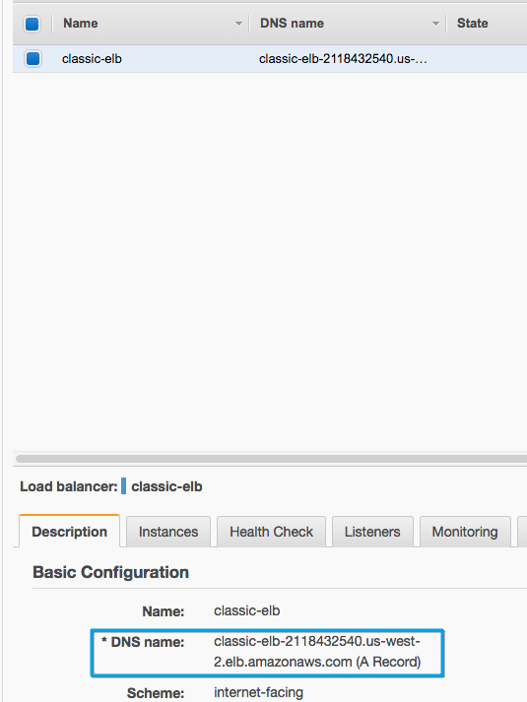
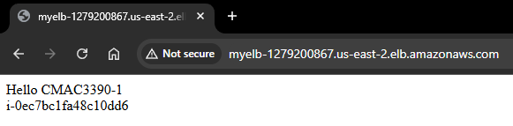
Elastic Load Balancer
After the ELB is active copy the Load Balancer DNS Name.
Paste this address into a new tab in your browser
(don't include the "A Record" information in parentheses):
You should be able to see something like this:
Click refresh on the page a couple of times to see this value
changing. This means that both instances are in service,
and the ELB service is forwarding the traffic to a different
instance each time you hit refresh.

Slide 32
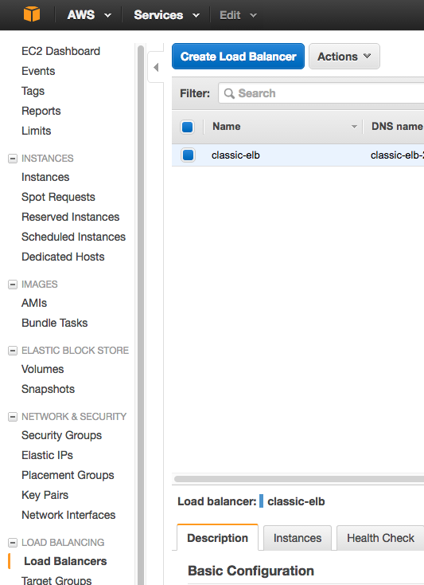
Elastic Load Balancer
Note if you take the public DNS address of the instance itself and try
to access it directly, you should be able to load the same page.
Notice you are accessing a particular instance directly, and we want
to avoid that. To do so we need to change a few things.
This is happening because the SG associated with the EC2 instances
is allowing access from anywhere to the port 80; we want to change
it so that the instances will only allow traffic coming from the ELB

Slide 33
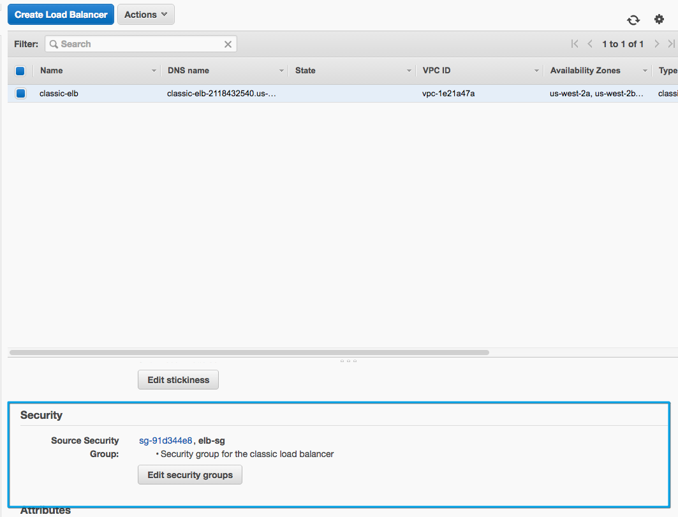
Elastic Load Balancer
To configure the security settings we want, go back to the EC2 management console on
the Load Balancers page:
  With the LB selected, go to the Security tab
    Edit the security groups, remove the default SG, save
    The LB now only has the Web-App-SG with http & https access
Next, go back to the Security Groups page
  Edit the two launch wizard security groups inbound rules
    Remove ports 80 and 443 from the SG’s
    The instances now only accept SSH traffic on port 22

Slide 34
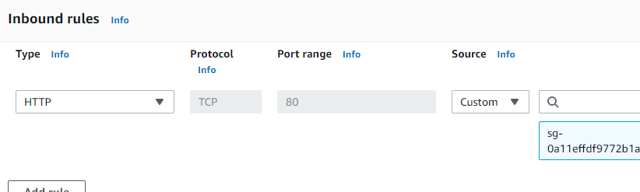
Elastic Load Balancer
Now, create another new security group
  Call it Web-Instance-SG or similar
    Add inbound HTTP & HTTPS rules, with the source being our Web-App-SG that we created earlier.
    Change our instances to only have this security group, remove the web-app-sg and launch-wizard sg.
OK so, now our instances are only accepting HTTP/HTTPS traffic from our load balancer
  Awesome!
Our load balancer accepts traffic from the internet and forwards to our instances
  Perfect!
Can we do this all through code?
  Obviously, if you’ve been
  paying attention at all!

Slide 35
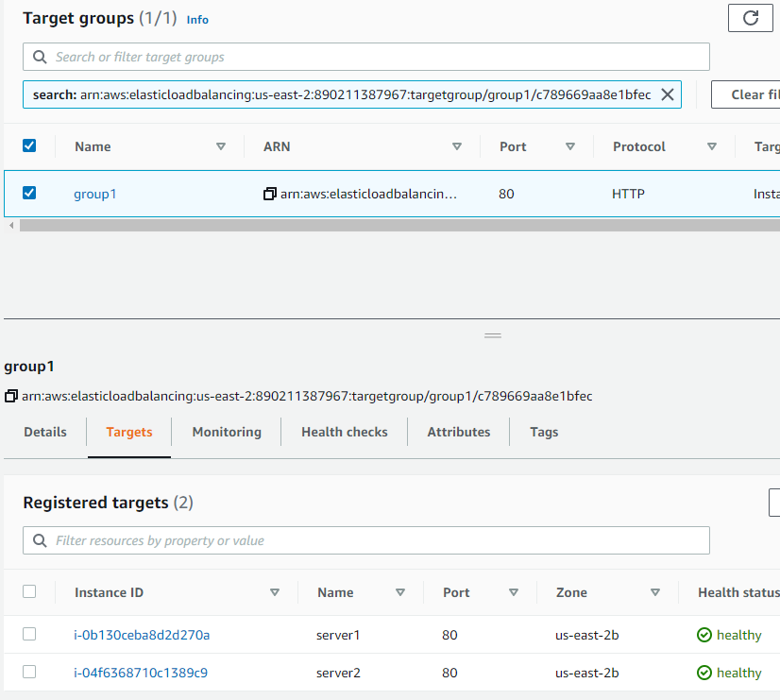
Elastic Load Balancer
Open the Load Balancers Target Groups
  If you select the group then click the Targets tab,
  you will be able to see both instances are healthy
This means that the instances are answering
the health checks configured during the
ELB's creation, so they will be used
To see what happens with the ELB when there
is a problem in a particular instance, we can
simulate an instance failure.
The easiest way to do this is to stop a running
instance, so let's do that.

Slide 36
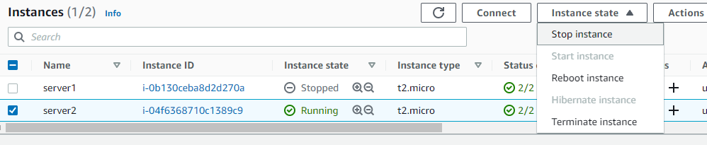
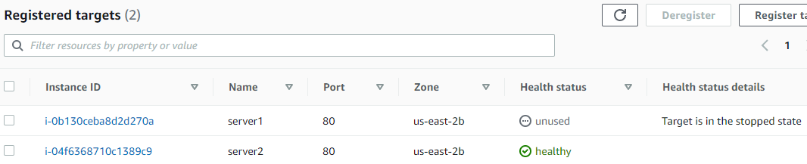
Elastic Load Balancer
Go to instances, choose a running instance, click on Instance State, then on Stop Instance:
Doing this will stop a particular instance, which will make it fail the ELB's health checks.
Click on Target Groups, then your group,
and the Targets tab, and watch the
instance go unhealthy or unused →

Slide 37
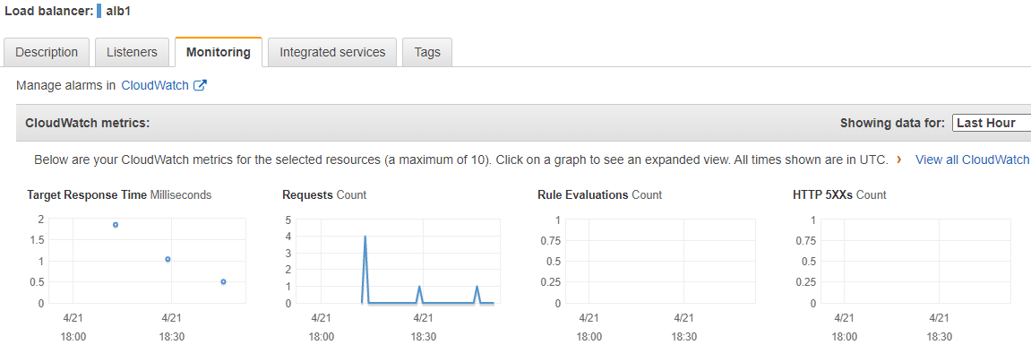
Elastic Load Balancer
There is also a ton of monitoring available by default.
Go to the ELB, and click on the Monitoring tab to see the metrics of the ELB you selected:
  There are various metrics. Explore them!

Slide 38
AWS GUI Task - Windows
Login to AWS
Validate region
Navigate to EC2 dashboard
Launch Instance
Select Microsoft Windows Server 2025 Base
Make sure to use the t3.micro instance type
Launch!
Create a new keypair! Give it a name! Download the keypair!
Launch Instances!
Go to View Instances to see the status…

Slide 39
AWS GUI Task - Windows
View Instances
Enable IMDSv1!
  Actions → Instance Settings → Modify instance metadata settings → IDMSv2 Optional!
Right click on instance and select Security → Get Windows Password (~5 minutes)
Decrypt the password using your downloaded key file!
Connect to instance – RDP client
  You can download a pre-configured RDP file
  You could also manually open an RDP connection to the public IP
Log in and do work!
  Check http://169.254.269.254 in a web browser
    http://169.254.169.254/latest/meta-data/
    This is a site local to the instance that can be used for pulling data about the thing
  OK now terminate this rubbish and deploy a real OS.

Slide 40
AWS GUI Task – Linux
Login to AWS
Validate region
Navigate to EC2 dashboard
Launch Instance
Select Amazon Linux 2023 kernel-6.1 AMI
Make sure to use the t3.micro instance type
Launch!
Create a new keypair! Make sure to download the keypair!
Launch Instances!
Go to View Instances to see the status…

Slide 41
AWS GUI Task – Linux
Copy your .pem file to a Linux machine!
  Make sure the .pem file is secure on your Linux machine!
    chmod 600 keyfile.pem
  You can download PuttyGEN to create the appropriate
  key file in Windows, but that’s gross.
    Convert the .pem to a .ppk or something, import this new key into putty…
Connect to instance
  Open an SSH connection using a command similar to below:
    ssh -i /path/to/keypair.pem ec2-user@server-ip-address
Log in and do work!
  Sudo to root! (sudo -i)
  Check http://169.254.269.254 from the command line (enable IMDSv1!)
    curl http://169.254.169.254/latest/meta-data/instance-id
    This is a site local to the instance that can be used for pulling data about the things
  Ok. Now what? Let’s delete that instance…

Slide 42
AWS Tasks - Cleanup
Make sure to delete anything you created!
You will be billed for running *or* unused reserved resources!
  IPv4 addresses that are assigned to an instance
    Even if the instance is stopped!
  Disks allocated
    Even if not assigned to an instance!
  Databases
  Load Balancers
  More…
Delete all the stuff we created
  Multiple EC2 instances
  Load Balancers
  Security Groups
  Target Groups
  Keys
  Other…

Slide 43
CMAC 3990.200
Systems Administration and Operations
Fall 2025 – Week 12.2 – November 13th, 2025
Clouds – CLI Setups & IAM

Slide 44
Amazon Web Services
EC2 – Elastic Compute Cloud – The Amazon Web Services component
Instance – Virtual Machine – A running VM, similar to our class VM’s
Amazon Machine Image (AMI) – Template – An OS installed and pre-configured to quickly deploy
Virtual Private Cloud (VPC) – Network – A virtual private non-routable network subnet
Internet Gateway (IGW) – Gateway/router – Next hop to the internet
Region – A generalized location where AWS physical services are located
Availability Zone – An individual data center within a region
Security Group – A virtual firewall
Elastic Load Balancer (ELB) – The Elastic Load Balancing Service from Amazon
will automatically distribute incoming application traffic across multiple
Amazon EC2 instances.
  Load balancers allow you to achieve fault tolerance in your applications,
  seamlessly providing the required amount of load balancing capacity
  needed to route application traffic.

Slide 45
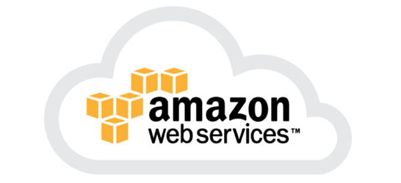
Intro to Amazon Web Services
AWS Regions
  Fairly independent collections of data centers
  within a specific geographic area
    US East, N Virginia, us-east-1
    US West, Oregon, us-west-2
    Asia Pacific, Tokyo, ap-northeast-1
  https://www.cloudping.info/
Availability Zones
  A specific zone within an AWS Region
  Separate datacenters
  Low latency connections between AZ’s
  Provides for fault-tolerant designs
    If an AZ goes offline, you can run on another AZ in that region
Geolocation!

Slide 46
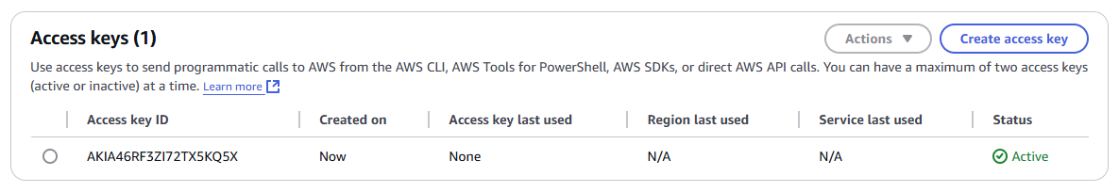
AWS CLI Task – Linux
Get your AWS CLI credentials!
  In order to do CLI commands, we need to create a new access key
    Click the drop down arrow next your Account ID in the upper right corner and select Security credentials
    Scroll down to Access Keys
    Create a new Access Key!
      For our class, we are the “root” user and creating keys for this user. Not a best practice, but OK for today…
      Make sure to download the key file or copy the info on screen!
        You will only have one opportunity to retrieve this Secret Access key!
Now we can do some
automated builds!
Hooray!

Slide 47

AWS CLI Task – Linux
Let’s build a VM via code from the command line! Log on to your EUP VM…
1. Install epel, awscli, jq on your EUP VM!
  dnf config-manager --set-enabled crb
  dnf -y install https://dl.fedoraproject.org/pub/epel/epel{,-next}-release-latest-9.noarch.rpm
  dnf -y install jq
  curl "https://awscli.amazonaws.com/awscli-exe-linux-x86_64.zip" -o "awscliv2.zip"
  unzip awscliv2.zip
  sudo ./aws/install
  2. Create ~/.aws/credentials on your EUP VM!
  Account Details → …
    mkdir -p ~/.aws/
    vi ~/.aws/credentials
    [default]
    aws_access_key_id = AKIA46RFJK…
    aws_secret_access_key = 5e1eUHYuD9…
Replace these with your credentials!

Slide 48
AWS CLI Task – Linux
3. Configure awscli
  /usr/local/bin/aws configure
    → default region us-east-2
    → default output json
4. Create a key pair and secure the key file!
  /usr/local/bin/aws ec2 create-key-pair --key-name CMAC3990-Key | jq -r ".KeyMaterial" > cmac3990-key.pem
  chmod 600 cmac3990-key.pem
5. Create a security group named CMAC3990-SG
  /usr/local/bin/aws ec2 create-security-group --group-name CMAC3990-SG --description "SSH and WWW Access for CMAC-3990"
6. Allow SSH & HTTP access into security group
  /usr/local/bin/aws ec2 authorize-security-group-ingress --group-name CMAC3990-SG --protocol tcp --port 22 --cidr 0.0.0.0/0
  /usr/local/bin/aws ec2 authorize-security-group-ingress --group-name CMAC3990-SG --protocol tcp --port 80 --cidr 0.0.0.0/0

Slide 49
AWS CLI Task – Linux
7. Create a user-data file
  echo -e '#!/bin/bash\n\nsudo dnf -y install httpd\nsudo systemctl enable httpd --now' > userdata.txt
  echo -e 'sudo echo "Hello CMAC3990 from Amazon CLI" > /var/www/html/index.html' >> userdata.txt
8. Create an instance!
  /usr/local/bin/aws ec2 run-instances --image-id ami-083b3f53cbda7e5a4 --count 1 --instance-type t2.micro --key-name CMAC3990-Key --security-groups CMAC3990-SG --user-data file://userdata.txt
    The above command is all one line…
9. Find public IP address
  /usr/local/bin/aws ec2 describe-instances | grep PublicIpAddress | tail -n1
10. Connect…
  ssh -i cmac3990-key.pem ec2-user@PublicIpAddress
  exit
11. Check! – Run on your EUP VM!
  curl -O https://jpatalon.cs.edinboro.edu/cmac3990/classfiles/assignment-aws-check.sh
  sudo bash assignment-aws-check.sh

Slide 50
AWS CLI Task – Linux
Do some more work!
  Update Security Group Rules
    Allow https
      /usr/local/bin/aws ec2 authorize-security-group-ingress --group-name CMAC3990-SG --protocol tcp --port 443 --cidr 0.0.0.0/0
  Browse to web page (HTTP, not HTTPS!)
    http://PublicIpAddress
      We did not configure HTTPS here…
Explore IMDSv2 metadata (run these two commands from EC2 instance)
  TOKEN=$(curl -X PUT "http://169.254.169.254/latest/api/token" -H "X-aws-ec2-metadata-token-ttl-seconds: 21600")
  echo;curl -q -H "X-aws-ec2-metadata-token: $TOKEN" http://169.254.169.254/latest/meta-data/instance-id;echo;echo
More? JQ?
  jq is like sed for JSON data - you can use it to slice and filter and map and transform structured data with the same ease that sed, awk, grep and friends let you play with text.

Slide 51
AWS CLI Task – Linux
12. Destroy instance (run these commands from CSCI3990 VM)
  Find instance ID:
    /usr/local/bin/aws ec2 describe-instances | grep InstanceId
  Terminate/destroy instance:
    /usr/local/bin/aws ec2 terminate-instances --instance-ids <value>
13. Delete security group (have to wait for instance to shut down!)
  /usr/local/bin/aws ec2 delete-security-group --group-name CMAC3990-SG
14. Delete key pair
  /usr/local/bin/aws ec2 delete-key-pair --key-name CMAC3990-Key
15. Validate in Web GUI (Check that you are in the correct region!)
  Anything we leave running we will be billed for!
    Instances
    Load balancers
    Things that are configured to run as code, and are run (Lambda, etc)
    Others…

Slide 52

AWS Identity & Access Management (IAM)
Securely manage identities and access to AWS services and resources
Set and manage guardrails and fine-grained access controls for your workforce and workloads.
Manage identities across single AWS accounts or centrally connect identities to multiple AWS accounts.
Grant temporary security credentials for workloads that access your AWS resources.
Continually analyze access to right-size permissions on the journey to least privilege.
With AWS Identity and Access Management (IAM), you can specify who or what
can access services and resources in AWS, centrally manage fine-grained
permissions, and analyze access to refine permissions across AWS.
https://www.youtube.com/watch?v=SXSqhTn2DuE
  1 minute 17 seconds…

Slide 53
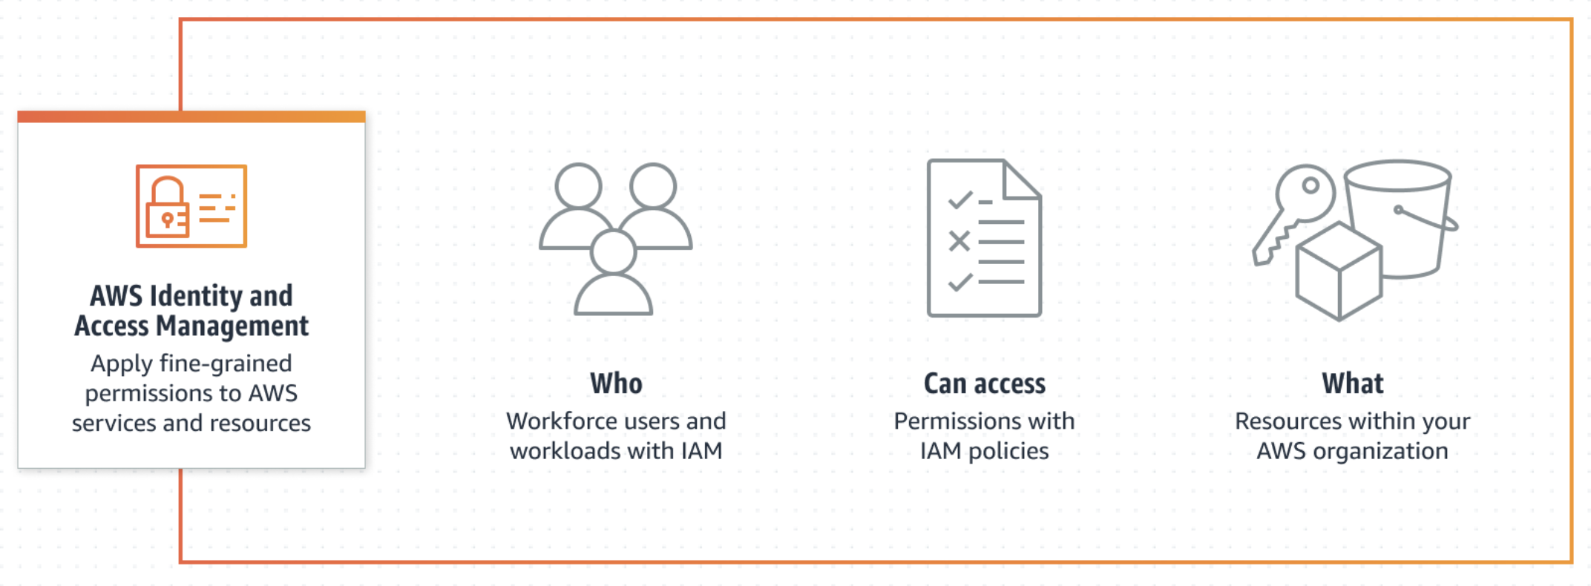
AWS Identity & Access Management (IAM)

Slide 54
AWS Identity & Access Management (IAM)
Apply fine-grained permissions and scale with attribute-based access control
  Create granular permissions based on user attributes—such as department, job role, and team name—by using attribute-based access control.
  Attribute-based access control (ABAC) is an authorization strategy that lets you create fine-grained permissions based on user attributes, such as department, job role, and team name.
  By specifying permissions using attributes, you can reduce the number of distinct permissions that you need for creating fine-grained controls in your AWS account.
  Instead of creating IAM roles with distinct policies for every team or individual to ensure the
  right levels of access, you can use ABAC to group attributes to identify which resources a set
  of users can access.
  As you add new users and resources, you can associate the appropriate attributes
  so that the right users have access to the right resources.
  You won’t need to to update existing policies to allow new users to access resources.

Slide 55
AWS Identity & Access Management (IAM)
Manage per-account access or scale access across AWS accounts and applications
  Use IAM or IAM Identity Center to provide multi-account access and application assignments across AWS.
  Users can use their directory credentials for single sign-on access to multiple AWS accounts.
  Users can also single sign-on through the AWS Command Line Interface (CLI), AWS SDKs, or AWS Console Mobile Application using their directory credentials for a consistent authentication experience.
  Enable single sign-on access to your AWS applications
  Securely access your Amazon EC2 Windows instances with existing corporate user names, passwords, and MFA devices - you are not required to share administrator credentials!
  You can centrally grant and revoke access to your EC2 Windows instances at scale
  across multiple AWS accounts.
  Enable single sign-on access to cloud-based applications as well!

Slide 56
AWS Identity & Access Management (IAM)
Establish organization-wide and preventative guardrails on AWS
  Use service control policies to establish permissions guardrails for IAM users and roles, and implement a data perimeter around your accounts in AWS Organizations.
  A data perimeter is a set of preventive guardrails in your AWS environment you use to help ensure that only your trusted identities are accessing trusted resources from expected networks. Data perimeter guardrails are meant to serve as always-on boundaries to help protect your data across a broad set of AWS accounts and resources.
  Implement organization-wide permissions guardrails that help prevent AWS accounts,
  organizational units, or an entire organization from taking actions that do not meet your
  security and compliance policies.
  Use data perimeters in your data loss prevention strategies to detect and help prevent
  intentional or unintentional transfers of sensitive information for unauthorized use.

Slide 57
AWS Identity & Access Management (IAM)
Set, verify, and right-size permissions toward least privilege
  Streamline permissions management and use cross-account findings as you set, verify, and refine policies on the journey toward least privilege.
  Policy generation with IAM Access Analyzer generates a fine-grained policy based on the access activity captured in your logs. This means that after you build and run an application, you can generate policies that grant only the required permissions to operate the application.
  Public and cross-account findings with IAM Access Analyzer guide you to verify that existing access meets your intent.
  When you turn on IAM Access Analyzer, it continuously monitors for new or updated
  resource permissions to help you identify permissions that grant public and
  cross-account access. For example, if an Amazon S3 bucket policy were to change,
  IAM Access Analyzer would alert you that the bucket is accessible by users from
  outside the account.

Slide 58
AWS Identity & Access Management (IAM)
Role Based Access Control (RBAC)
  The traditional authorization model used in IAM is called role-based access control (RBAC).
  RBAC defines permissions based on a person's job function, known outside of AWS as a role.
  Within AWS a role usually refers to an IAM role, which is an identity in IAM that you can assume.
  IAM does include managed policies for job functions that align permissions to a job function in an RBAC model.
  In IAM, you implement RBAC by creating different policies for different job functions. You then attach the policies to identities (IAM users, groups of users, or IAM roles).
  As a best practice, you grant the minimum permissions necessary for the job function.
    This is known as granting least privilege!
    Do this by listing the specific resources that the job function can access.
  The disadvantage to using the traditional RBAC model is that when employees add
  new resources, you must update policies to allow access to those resources.

Slide 59
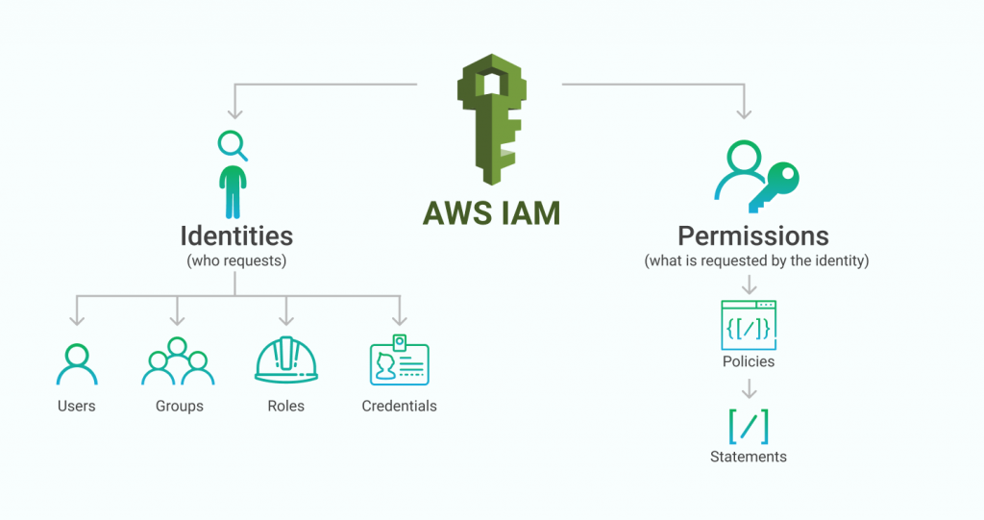
AWS Identity & Access Management (IAM)

Slide 60
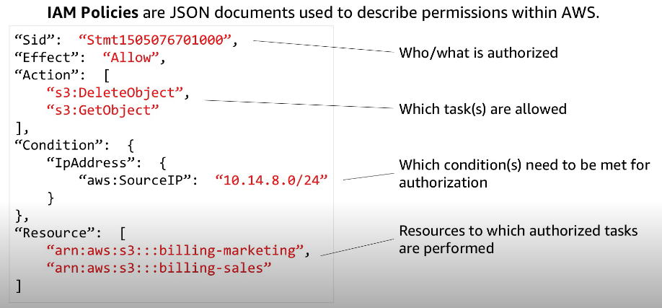
AWS Identity & Access Management (IAM)

Slide 61
AWS Training & Certification Events
Entry level AWS Certification – AWS Certified Cloud Practitioner
Free training, live webinars, practice exams, more…
  Define what the AWS Cloud is and the basic global infrastructure
  Describe basic AWS Cloud architectural principles, Describe the AWS Cloud value proposition
  Describe key services on the AWS platform and their common use cases (for example, compute and analytics)
  Describe basic security and compliance aspects of the AWS platform and the shared security model
  Define the billing, account management, and pricing models
  Identify sources of documentation or technical assistance (for example, whitepapers or support tickets)
  Describe basic/core characteristics of deploying and operating in the AWS Cloud
https://aws.amazon.com/certification/certified-cloud-practitioner
https://aws.amazon.com/training/events

Slide 62
HW AWS
50 Points – Bonus!
HW AWS – Cloud Build – Due December 5th, 2025
  Build an instance
  Run Updates
  Run check script from your EUP VM!
  Documentation!
  Did we just do this???
Bonus!

Slide 63

Assignments 11-13, AWS
Assignment 11 – 63 points – Due November 14th, 2025
  Survey and Questionnaire
  https://jpatalon.cs.edinboro.edu/cmac3990/Assignment%2011.pdf
Assignment 12 – 72 points – Due November 21st, 2025
  Network updates, Switch to Docker-CE, OwnCloud vs. NextCloud, Disk updates
  https://jpatalon.cs.edinboro.edu/cmac3990/Assignment%2012.pdf
Assignment 13 – 65 points – Due December 5th, 2025
  Final additional/related tasks – good for review…
  https://jpatalon.cs.edinboro.edu/cmac3990/Assignment%2013.pdf
Assignment AWS – 50 points bonus – Due December 5th, 2025
  AWS CLI deployment
  https://jpatalon.cs.edinboro.edu/cmac3990/Assignment%20AWS.pdf

Slide 64
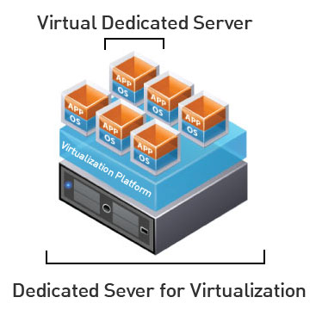
Virtual Machines
VM Info:
  IP Address: 147.64.243.1##/23 (01-20) – bond0
  Hostname: cmac3990-1##.cs.edinboro.edu (01-20)
  Alias: 41##.megastuff.biz (01-20)
  Samba: \\147.64.243.1##\ (01-20)
  Interfaces:
    Enp1s0, enp8s0, enp9s0, enp10s0, mybond0, mybond0.6, mybond0.110, mybond0.187
  IP’s
    mybond0 – 147.64.243.1## & 147.64.243.150+##/23
    mybond0.6 – fd06:1234:5678:beef:1##::1/64
    mybond0.110 – 10.10.1##.1/16
    mybond0.187 – 10.1.187.1##/22
  Additional IP’s…
    mybond1 – 192.168.1.1##/24 & 192.168.1.2##/24 & fd06:8765:4321:face:1##::1/64
    mybond1.399 – 192.168.1##.25/19
    mybond1.222 – 10.222.222.2##/22

Slide 65
Virtual Machines
IP Address: 147.64.243.1## (01-15)
Hostname: cmac3990-1##.cs.edinboro.edu (01-15)
Alias (01-15):
  ##.megastuff.biz
  1##.megastuff.biz
  41##.megastuff.biz (subdomain)
    SOA, NS, A, MX
    www, ipv6, newprivate1, private2, midterm1-4?
  Nextcloud.1##.megastuff.biz
  Owncloud.1##.megastuff.biz
We didn’t really use these aliases

Slide 66

Linux Commands
aws

Slide 67

Key Terms and Items
Cloud
AWS
EC2
Security Groups
Elastic Load Balancer
Auto Scaling Groups
Scaling Policies
Launch Templates
Target Groups
Keys

Slide 68

For Next Week
“They who can give up essential liberty to obtain a little temporary safety deserve neither liberty nor safety.” –Benjamin Franklin
Textbook:
  Chapters 17-19: SSO, E-Mail, Web hosting
Next week topics
  More Cloud
Continuing work with VM’s

